Slide 1
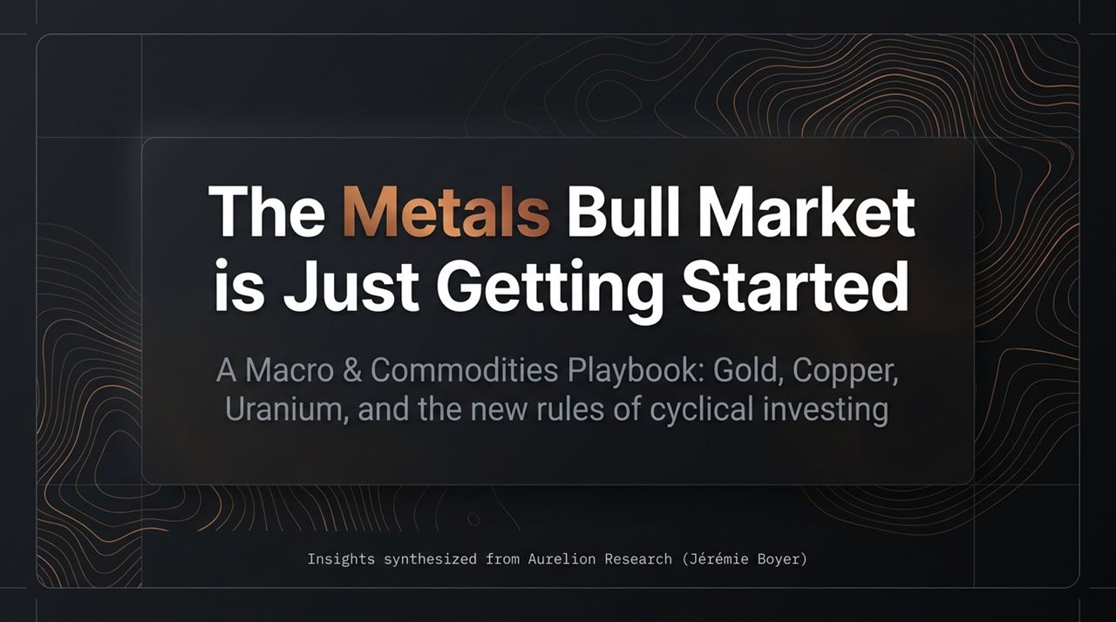
Notes:
Introduction & Opening:
Welcome everyone. Today, we are taking a deep dive into Aurelion Research’s latest macro and commodities playbook, presented by Jérémie Boyer.
Over the past few years, the commodity space has undergone a massive paradigm shift. While the narrative in the financial media has been heavily dominated by the AI boom, physical commodities have taken center stage in 2026, driven by a combination of spiraling inflation, fiscal deficits, geopolitical friction, and energy security mandates.
Core Premise:
The central thesis of this presentation is straightforward: The traditional, monolithic cyclical playbook of the 2010s is obsolete.
We are entering a new metals supercycle where key structural tailwinds are accelerating high-conviction metals like Gold, Copper, and Uranium, while structural headwinds continue to drag down traditional energy sectors like Crude Oil and Fertilizers.
Over the next 45 to 50 minutes, we will unpack Aurelion Research’s cross-asset framework, examine the broken market correlations, breakdown specific asset allocations, and outline exact portfolio execution strategies.
https://www.youtube.com/watch?v=1Lylw0Anyxk

Slide 2
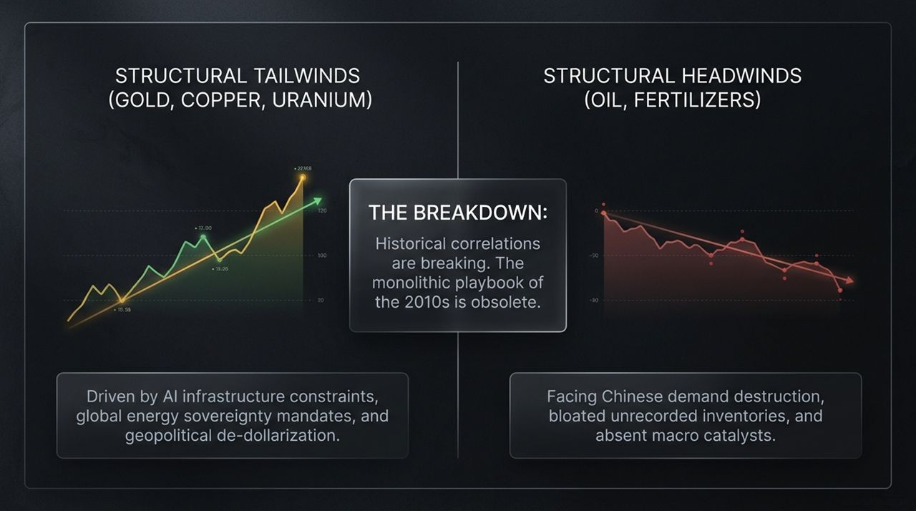
Notes:
The Core Breakdown:
To understand this market, you must first accept that historical correlations across the commodity complex are breaking down. In previous cycles, commodities tended to move as a unified block—if energy rallied, broad industrial metals and agricultural components followed. That is no longer the case.
Structural Tailwinds (Gold, Copper, Uranium):
On the left, we see a clear structural bull market in selected metals.
Gold is being propelled by sovereign physical accumulation, de-dollarization, and massive institutional capital rotation.
Copper is hitting a physical wall due to AI infrastructure requirements, grid modernizations, and a structural supply deficit that takes over a decade to fix.
Uranium is supported by price-insensitive utility buyers and government baseload energy sovereignty mandates.
Structural Headwinds (Oil, Fertilizers):
Conversely, energy and agricultural inputs are suffering from structural weakness.
Crude Oil is being burdened by Chinese demand destruction—as China pivots to coal and renewables while consumer spending softens—and hidden physical supply moving via dark fleets.

Slide 3
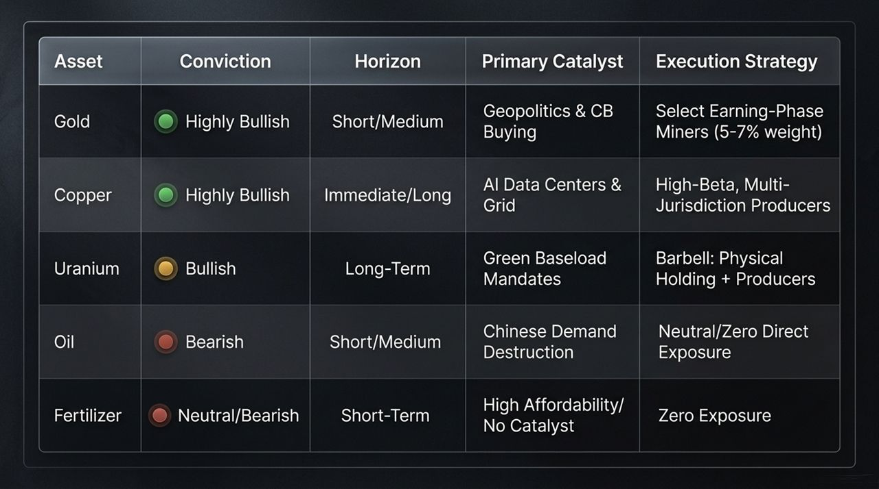
Notes:
Overview of Asset Class Framework:
This matrix summarizes Aurelion’s conviction level, time horizon, catalyst drivers, and execution strategy across all five key commodities.
Detailed Breakdown by Asset:
Gold: Highly Bullish | Short/Medium Horizon. Driven by geopolitical instability and central bank buying. Execution is focused on selecting mid-tier miners entering their Earning Phase with a strict 5–7% portfolio weighting.
Copper: Highly Bullish | Immediate/Long Horizon. Catalyzed by AI data center builds and power grid buildouts. Execution focuses on high-beta, multi-jurisdictional producers with low CapEx profiles.
Uranium: Bullish | Long-Term Horizon. Driven by global green baseload mandates. Executed via a barbell strategy: holding direct physical uranium vehicles paired with select equity producers.
Oil: Bearish | Short/Medium Horizon. Weakened by structural Chinese demand destruction. Strategy calls for zero direct crude exposure.
Fertilizer: Neutral/Bearish | Short-Term Horizon. High affordability, high supply, and lack of bullish data. Execution strategy dictates zero allocation.

Slide 4
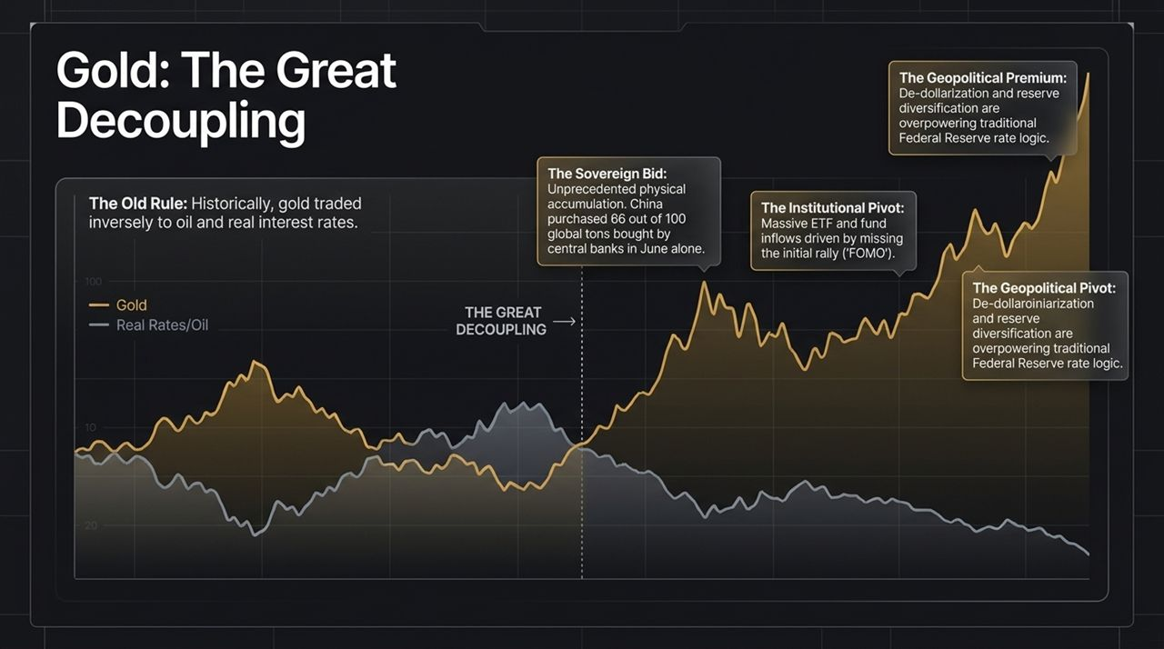
Notes:
The Historical Context vs. The Breakdown:
Historically, gold traded with a predictable inverse relationship to real interest rates and crude oil prices. When real rates rose or oil crashed, gold would sell off.
However, starting around mid-2024 (and accelerating through July/August), gold underwent The Great Decoupling. It detached from Federal Reserve rate hike logic and crude oil price action.
Three Pillars Driving Gold to $5,000/oz:
The Sovereign Bid: Unprecedented central bank physical accumulation. In June alone, China purchased 66 out of the 100 global metric tons acquired by global central banks.
The Geopolitical Premium: Post-2022 asset freezing highlighted the risks of holding paper Western reserves. Non-aligned nations and sovereign entities are aggressively shifting reserves into physical gold.
The Institutional Pivot: Generalist funds and ETFs that completely missed the initial rally are experiencing intense FOMO. With gold surging 2% daily and unhedged miners up 30-40% in a month, institutional managers are forced to chase performance.

Slide 5
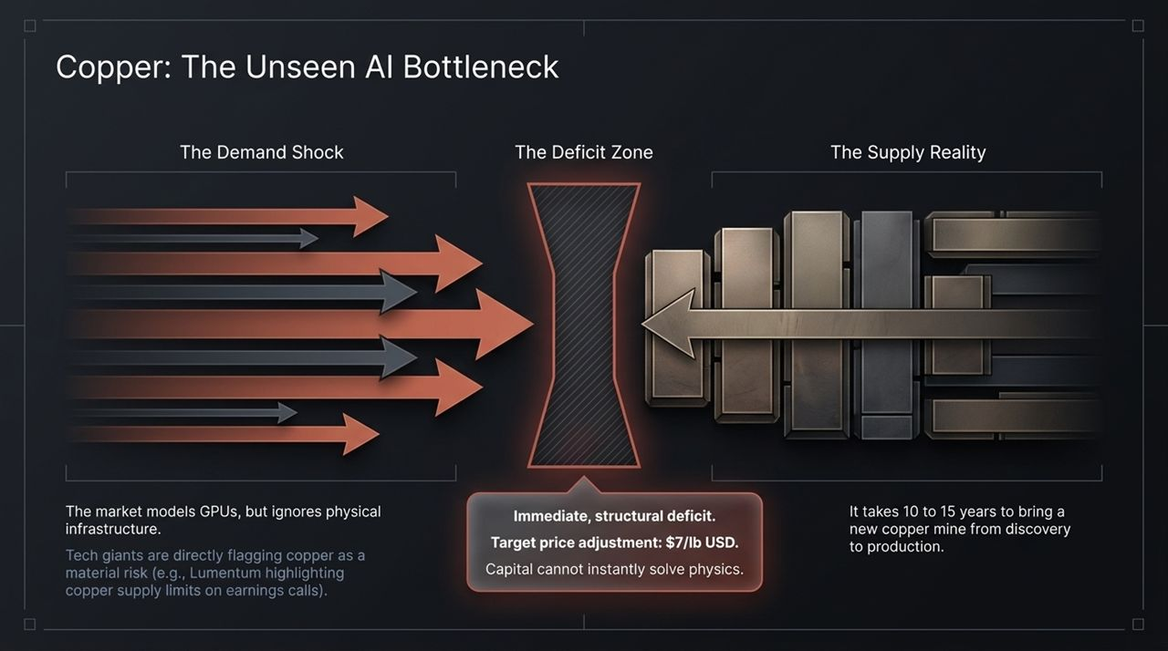
Notes:
The Demand Shock:
Silicon Valley and Wall Street are hyper-focused on GPU compute power, chip design, and software algorithms. However, the digital revolution is hitting a hard physical bottleneck: power and transmission.
Tech companies and photonics manufacturers (like Lumentum) are now acknowledging in earnings calls and footnote risk disclosures that copper supply is a critical risk factor to their growth.
The Deficit Zone & Supply Reality:
We are entering an immediate structural deficit. Aurelion sets a target price adjustment of $7.00/lb in the near term.
Physics vs. Capital: You cannot simply throw money at a software problem to build a mine overnight. Bringing a new copper mine from discovery to commercial production takes 10 to 15 years. Capital cannot instantly overcome lead times and permitting physics.

Slide 6
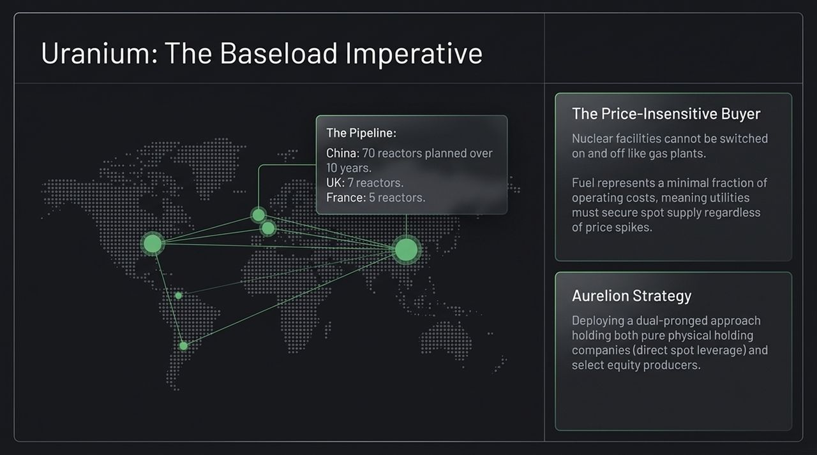
Notes:
The Structural Pipeline:
Governments worldwide are realizing that solar and wind cannot provide reliable 24/7 power for heavy industry and AI data centers.
Nuclear energy is the only zero-emission baseload alternative. China alone has 70 nuclear reactors planned over the next decade, with the UK, France, India, and even former anti-nuclear nations like Germany moving to build or extend reactor life.
The Price-Insensitive Buyer:
Nuclear reactors cannot simply be switched on and off like natural gas facilities. They must run continuously.
Furthermore, physical uranium fuel accounts for a tiny fraction of a plant's overall operating cost. Consequently, utility procurement officers are completely price-insensitive; they will pay whatever spot price is required to secure long-term utility supply.
Aurelion Strategy:
Implements a barbell approach: physical holding companies (direct spot price leverage without operating risk) paired with low-cost equity producers.

Slide 7
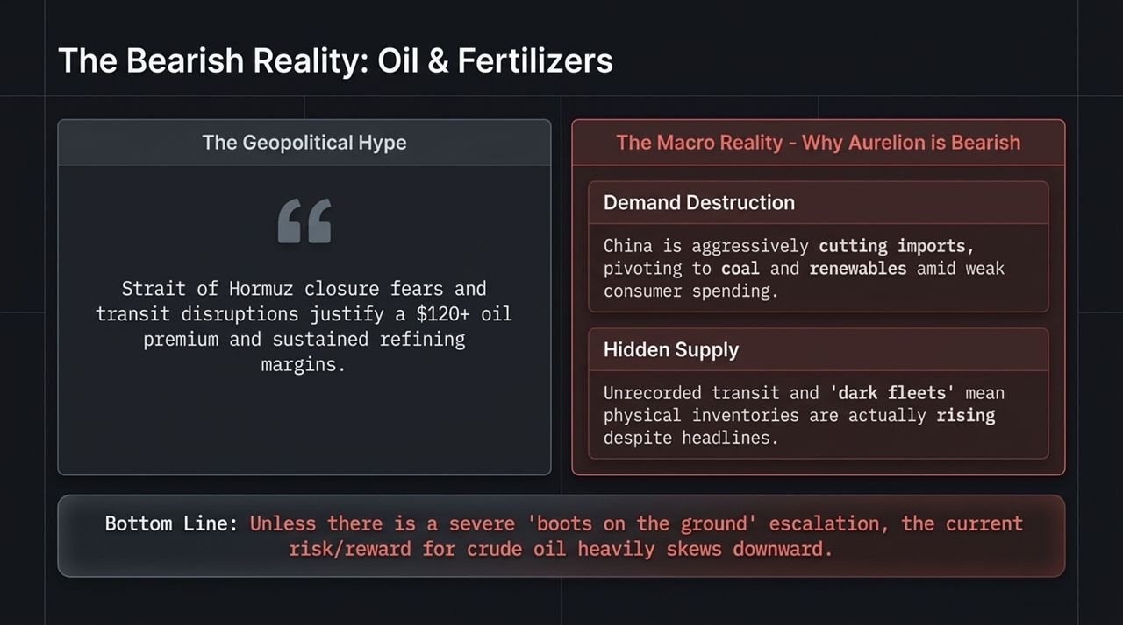
Notes:
The Geopolitical Hype vs. Macro Reality:
The common market narrative claims that middle-eastern transit disruptions and Hormuz escalation justify a $120+ oil premium. Aurelion takes a firm contrarian, bearish stance.
Why Aurelion is Bearish on Oil:
Chinese Demand Destruction: China is structurally lowering oil imports by shifting toward coal, renewables, and EVs amid slowing consumer spending.
Hidden Supply & Dark Fleets: Contrary to selective headline charts showing declining US inventories, global physical crude inventories are rising due to unrecorded transit and dark fleet movements.
Bottom Line: Unless there is direct boots on the ground military action involving major production infrastructure, the risk/reward skew for oil is overwhelmingly to the downside.

Slide 8
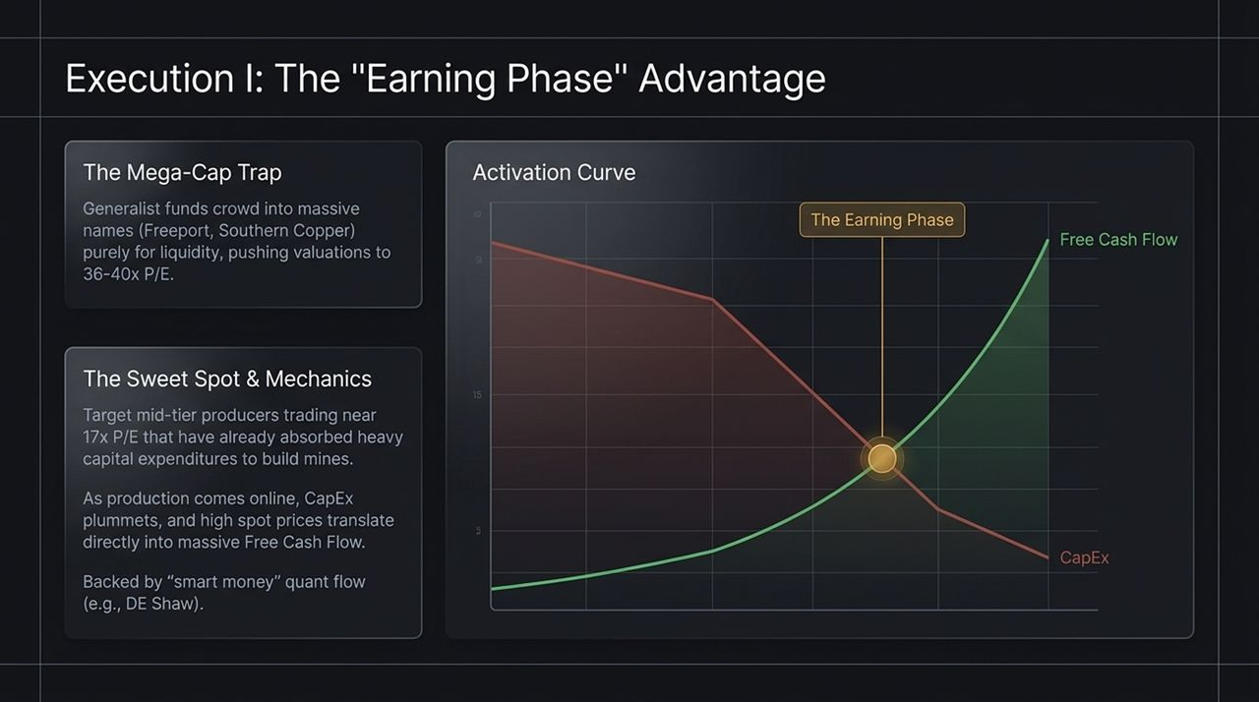
Notes:
The Mega-Cap Trap:
Most generalist institutional funds seeking copper or gold exposure default to buying mega-cap names like Freeport-McMoRan or Southern Copper simply because they offer high daily liquidity.
This crowding has pushed mega-cap valuations to inflated multiples of 36x–40x P/E.
The Activation Curve & Earning Phase:
Aurelion focuses on mid-tier producers ($10B market cap range) trading around 17x P/E.
The Mechanics: These mid-tier companies have already completed their heavy Capital Expenditure (CapEx) buildout cycle. As mines transition into active production, CapEx plummets right as high commodity spot prices kick in. This creates an explosive inflection point in Free Cash Flow (FCF) generation.
Smart quant capital (e.g., D.E. Shaw) quietly builds significant positions in these overlooked mid-tier cash generators.

Slide 9
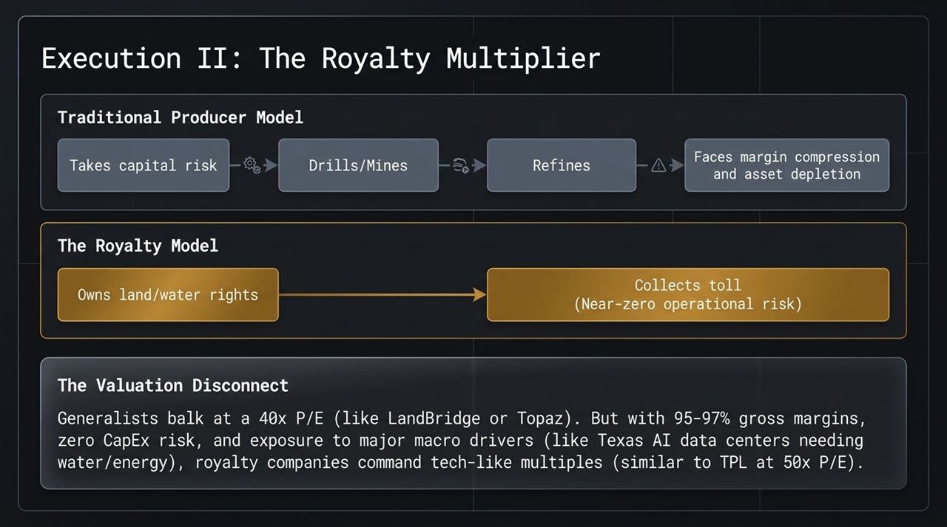
Notes:
Producer vs. Royalty Model:
Traditional Producer: Incurs massive CapEx, exploration risk, environmental permitting liabilities, refining costs, and asset depletion.
Royalty Model: Owns the underlying land or water rights, leasing them out to operators in exchange for top-line revenue cuts. Near-zero operating cost, zero CapEx inflation risk, and 95%–97% gross margins.
The Valuation Disconnect:
Traditional generalist investors balk at paying 40x P/E for royalty businesses like LandBridge or Topaz.
However, when a company has tech-like gross margins, zero CapEx liability, and exposure to major secular drivers (such as Permian Basin water rights sold to Texas AI data centers), it commands high multiples similar to Texas Pacific Land Trust (TPL) at 50x P/E.

Slide 10
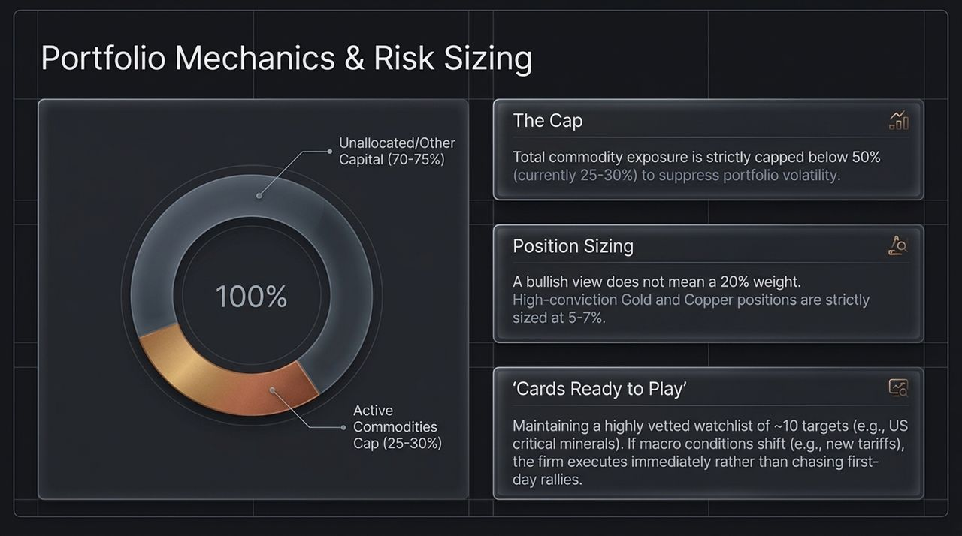
Notes:
Risk Management Framework:
High conviction does not mean reckless capital allocation. Capital preservation and low volatility are core mandates.
Portfolio Guardrails:
Strict Total Cap: Overall active commodity exposure is capped strictly below 50% (currently hovering between 25%–30%) to limit portfolio drawdowns.
Individual Position Sizing: Even for top bullish calls (Gold/Copper), individual equity weightings are strictly capped at 5%–7%.
Cards Ready to Play: Maintain a vetted watchlist of ~10 tactical targets (such as US critical minerals plays). If macro catalysts trigger (e.g., new US-Canada trade tariffs), capital is executed immediately rather than chasing late-stage rallies.

Slide 11
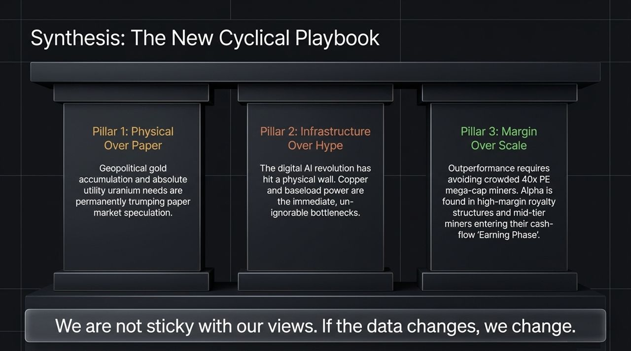
Notes:
Summary of the Three Strategic Pillars:
Pillar 1: Physical Over Paper. Central bank sovereign buying and utility contract requirements prove that physical asset demands outweigh paper market derivative pricing.
Pillar 2: Infrastructure Over Hype. The digital revolution requires physical power and conductors. Copper and nuclear baseload power are non-negotiable bottlenecks.
Pillar 3: Margin Over Scale. Alpha is generated by avoiding overcrowded 40x P/E mega-caps and targeting 95% margin royalty plays and mid-tier miners entering their cash-flow Earning Phase.
Agile Philosophy:
Macro investing requires flexibility. We are not sticky with our views. If the underlying data changes, we change.

Slide 12
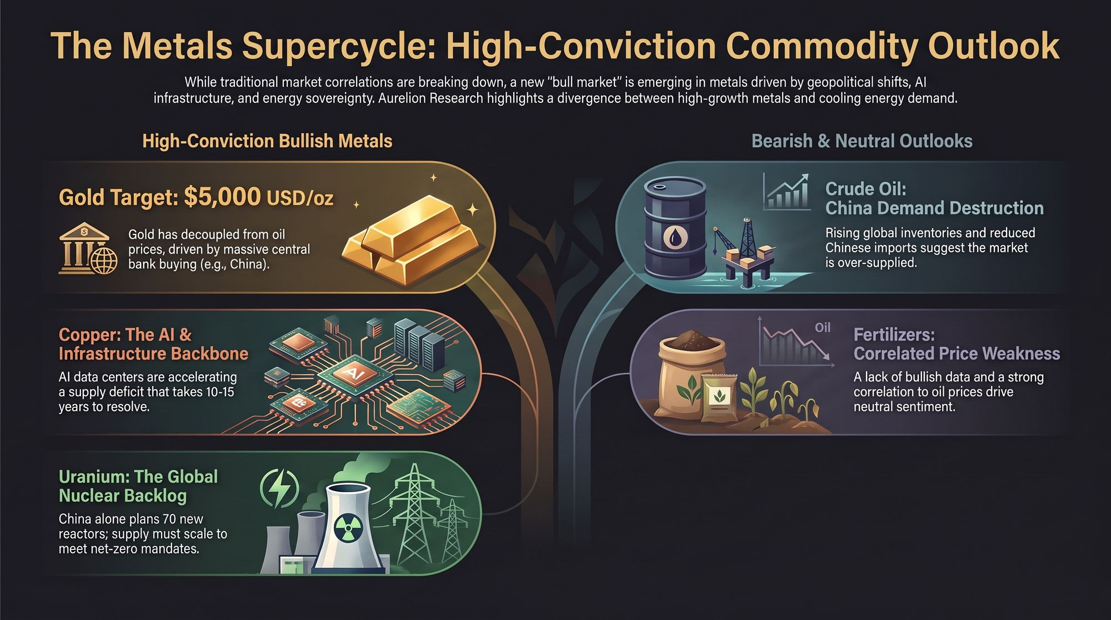
Notes:
Executive Summary / Closing Overview:
To conclude, we are witnessing a structural divergence across global commodities.
Bullish Metals Side:
Gold: Decoupled from rates/oil; central bank buying targets $5,000/oz.
Copper: The backbone of AI & power infrastructure; target $7.00/lb.
Uranium: Essential baseload power for global net-zero targets and reactor buildouts.
Bearish / Neutral Side:
Crude Oil: Chinese demand destruction and dark fleet inventory builds skew risk downward.
Fertilizers: High affordability and lack of bullish drivers keep sentiment neutral-to-bearish.
Closing Remarks:
Thank you for your time. We will now open the floor for Q&A.
https://www.youtube.com/watch?v=1Lylw0Anyxk

